Slide 1

TEXT SUMMARIZATION USING LANG-CHAIN REFINEMENT
Panel Head : Dr.B.Hariharan
Guide Name : Dr. Kaavya Kanagaraj
Student Name & Registration Number : A.Sachin Varma(RA2111026010403)
N.Bharath Chandra (RA2111026010376)

Slide 2
Abstract
This project aims to develop an advanced text summarization system utilizing the LangChain framework, which leverages the capabilities of large language models (LLMs) to generate concise and informative summaries from extensive text documents. The primary objective is to create a modular, flexible, and scalable summarization workflow that can be customized for various applications, such as news article summarization, research paper abstraction, and summarization of legal documents.
LangChain’s modular architecture facilitates the creation of complex, multi-step workflows, enabling seamless integration of various pre-processing, inference, and post-processing operations. By utilizing state-of-the-art LLMs such as GPT-4, BART, or T5, the project ensures high-quality abstractive summarization,

Slide 3
capturing the essential information and key insights from the source text while maintaining coherence and readability.Some of the key features of this project are Integration with LargeLanguageModels(LLM’S), scalability,Modularity and customization etc.
The project also emphasizes user-friendliness and ease of deployment, with comprehensive documentation and examples to facilitate rapid experimentation and implementation. By harnessing the power of LangChain, this text summarization system aims to significantly enhance information processing capabilities, aiding users in quickly comprehending large volumes of text and making informed decisions based on the summarized content

Slide 4
Introduction
The goal of this project is to develop a sophisticated text summarization system utilizing the LangChain framework, which leverages the power of large language models (LLMs) to distill extensive documents into clear, concise summaries. Traditional methods of summarization often fall short in capturing the nuanced details and key insights from large volumes of text, leading to either overly verbose or insufficiently detailed summaries. This project aims to address these challenges by creating a modular, flexible, and scalable summarization workflow that can be tailored for diverse applications, including news article summaries, research paper abstractions, and legal document summarization.

Slide 5
LITERATURE SURVEY
S.NO | TITLE AND YEAR | METHODOLOGY | GAPS AND LIMITATIONS
1. | Abstractive Long Text Summarization using Large Language Models (2024) | Utilizes summarization and question-answering methods; employs clustering and K-Means algorithm. | Potential factual inconsistencies in abstractive summarization; risk of introducing extraneous information not present in the original text.
2. | Exploring the Limits of ChatGPT for Query or Aspect-based Text Summarization (2023) | Evaluates ChatGPT's performance using publicly available datasets; benchmarks aspect and query-based text summarization. | Limited generalizability due to the maximum input sequence length of 5000 tokens, which restricts applicability to longer texts.

Slide 6
S.NO | TITLE AND YEAR | METHODOLOGY | GAPS AND LIMITATIONS
3. | NLP-based Text Summarization Techniques (2024) | Development of a news summarization web application using Streamlit. | Lack of information on scalability, handling large volumes of news articles, real-time updates, and computational resource requirements.
4. | Performance of BERT-based Models on Text Summarization" (2022) | Utilizes BERTSum as a baseline model, modified for experiments; introduces 'SqueezeBERTSum' using the SqueezeBERT encoder. | Potential limitations due to the dataset size and diversity, which may impact the generalizability of the results to other domains.

Slide 7
S.NO | TITLE AND YEAR | METHODOLOGY | GAPS AND LIMITATIONS
5. | Comparative Analysis of Extractive vs. Abstractive Text Summarization (2021) | Compares extractive and abstractive summarization techniques using various datasets. | Abstractive methods may generate text that introduces factual errors; extractive methods might miss the overall context.
6. | Domain-Specific Text Summarization Techniques (2020) | Focuses on domain-specific models for medical and legal texts using transfer learning. | Gaps and Limitations: Limited applicability to other domains; lack of a standard benchmark for comparison.

Slide 8
S.NO | TITLE AND YEAR | METHODOLOGY | GAPS AND LIMITATIONS
7. | Improving Summarization Accuracy with Reinforcement Learning (2019) | Applies reinforcement learning to train summarization models on reward functions tied to summary quality. | High computational cost and limited scalability to very large datasets
8. | Evaluating the Effectiveness of Hybrid Summarization Models (2022) | Combines extractive and abstractive techniques for hybrid summarization | Challenges in balancing content preservation with conciseness and readability.

Slide 9
S.NO | TITLE AND YEAR | METHODOLOGY | GAPS AND LIMITATIONS
9. | Multilingual Text Summarization: Current Approaches and Future Directions (2023) | Reviews current multilingual text summarization methods and suggests improvements. | Limited language support; issues with maintaining translation accuracy during summarization.
10. | Text Summarization for News Articles: An Evaluation of Current Models (2020) | Evaluates the performance of various summarization models specifically on news datasets. | Most models are tailored to English news datasets, with limited application to other languages or formats.

Slide 10
S.NO | TITLE AND YEAR | METHODOLOGY | GAPS AND LIMITATIONS
11. | Abstractive Text Summarization using Transformer Models (2018) | Utilizes transformer-based models like BERT and GPT-2 for summarization tasks. | Computationally intensive, requires large datasets and extensive fine-tuning.
12. | Advances in Query-Focused Summarization (2021) | Explores query-focused summarization methods using a combination of machine learning and natural language processing techniques. | Limited performance on highly complex or ambiguous queries.

Slide 11
S.NO | TITLE AND YEAR | METHODOLOGY | GAPS AND LIMITATIONS
13. | Sentiment-Based Summarization in Customer Feedback Analysis (2019) | Leverages sentiment analysis and summarization for processing customer feedback. | Over-reliance on sentiment polarity may ignore nuanced feedback and context.
14. | Real-Time Summarization for Social Media Data (2022) | Focuses on summarizing social media posts in real-time using neural networks. | Real-time processing constraints and high variability in social media content.

Slide 12
S.NO | TITLE AND YEAR | METHODOLOGY | GAPS AND LIMITATIONS
15. | Text Summarization using Graph-Based Approaches (2020) | Utilizes graph-based techniques to identify key sentences and themes for summarization. | May struggle with texts that lack clear structure or contain highly interconnected information.

Slide 13
LangChain
LangChain is a framework designed to facilitate the development of applications that use language models. It simplifies the process of building applications by providing tools and abstractions to work with large language models (LLMs) like OpenAI's GPT or other similar models.
Purpose of LangChain
The primary purpose of LangChain is to make it easier for developers to build and manage complex applications that require natural language processing (NLP) capabilities. It enables developers to focus on the higher-level logic of their applications while abstracting away much of the complexity involved in working directly with LLMs.

Slide 14
Uses of LangChain
Chaining Language Models: LangChain allows you to create chains or pipelines of different tasks that can be executed sequentially. For example, you might have one language model generate text, another model summarize it, and a third model translate it into another language.
Integrating with External Data: LangChain can be used to connect language models with external data sources. For example, it can fetch data from APIs, databases, or other systems and use that data in conjunction with language models.
Memory Management: LangChain supports memory capabilities, enabling language models to retain information across different interactions. This is particularly useful for building conversational agents that need to remember context over multiple exchanges.

Slide 15
Tool Use: It provides interfaces for language models to interact with tools such as calculators, search engines, or databases. This extends the capability of LLMs beyond just text generation, allowing them to perform specific tasks using external tools.
Application Development: Developers can use LangChain to build applications like chatbots, virtual assistants, or other NLP-based tools by integrating various language models and chaining them together to perform complex tasks.
In essence, LangChain is a powerful framework that simplifies the development of language model-based applications, making it easier to create sophisticated NLP solutions.

Slide 16
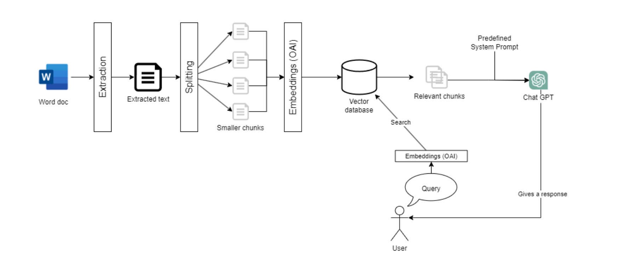

ARCHITECTURE

Slide 17
Purpose and use in text summarization
Automated Summarization Pipelines: LangChain enables the creation of automated pipelines that handle the entire process of text summarization. This can include steps like pre-processing the text, applying a language model to generate the summary, and then post-processing the output to ensure it meets specific quality criteria. These pipelines can be customized to suit different use cases, such as generating summaries for news articles, legal documents, or academic papers.
Integration with External Data Sources: In many cases, summarization might need to consider additional context from external data sources. LangChain allows language models to fetch and incorporate relevant data during the summarization process, leading to summaries that are not only concise but also enriched with relevant information that enhances their accuracy and usefulness.

Slide 18
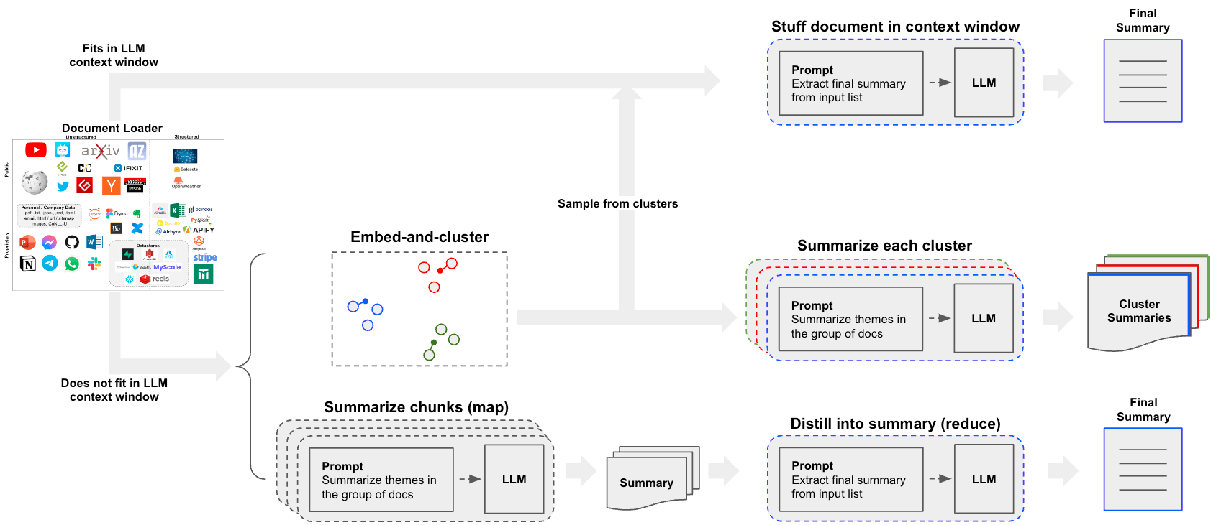

Slide 19
Task Chaining for Enhanced Summarization:
LangChain’s ability to chain tasks together is particularly useful in text summarization. For instance, a summarization task can be followed by a sentiment analysis task to provide a summary that not only condenses the text but also gives an insight into the overall sentiment. Similarly, summarization can be combined with keyword extraction to highlight the most important terms in the text.
Real-Time Summarization:
For applications that require real-time summarization, such as live news feeds or social media monitoring, LangChain can manage the flow of data, ensure that the summaries are generated quickly, and maintain high performance even with large volumes of incoming text. The framework’s ability to integrate with external APIs and data sources ensures that real-time data can be summarized effectively and efficiently.

Slide 20
Advantages of lang chain
LangChain offers several key advantages:
Task Chaining: Easily link multiple language model tasks, streamlining complex workflows.
Data Integration: Connect language models with external data sources for dynamic, context-aware applications.
Memory Management: Retain context across interactions, ideal for conversational agents.
Tool Integration: Extend language models' functionality by enabling them to interact

Slide 21
Customizability: Tailor applications to specific needs with flexible and modular components.
Scalability: Handle large-scale data and user demands efficiently.
Simplified Development: Reduce complexity and accelerate development with ready-to-use components.
Collaboration: Enhance teamwork with a clear, modular framework.
Error Handling: Robust tools for managing and debugging errors.
Community Support: Access resources and integrations from a growing ecosystem.

